Slide 1
Online Food Ordering System
Group – 37
Gyan Prakash – 2056
Madhavi S. Kotwal - 2076

Slide 2
Features:
The application will use MongoDB, Express, React, Node js as main web technologies.
Restaurants can register themselves simply by filling just a simple form and verifying their email which is handle by SMTP server, while registering restaurants, system uses Google Geocoding API to trace latitude & longitude of their registering addresses, which will be used further for searching nearby restaurant.
System contains Google Place API which helps customer to view their nearby restaurants by simply searching on search bar present on homepage or by starting their GPS.

Slide 3
Features:
Email validations using SMTP server make this web application a secured one.
System presents an interactive and up-to-date menu with all available options in an easy to use manner.
Customer can place one or many orders from their favorite nearby restaurants.
Customer can select items by searching through search bar or through the available lists there.

Slide 4
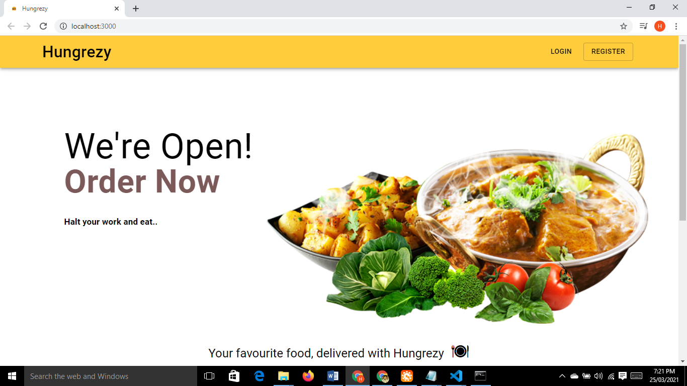
Home Page

Slide 5
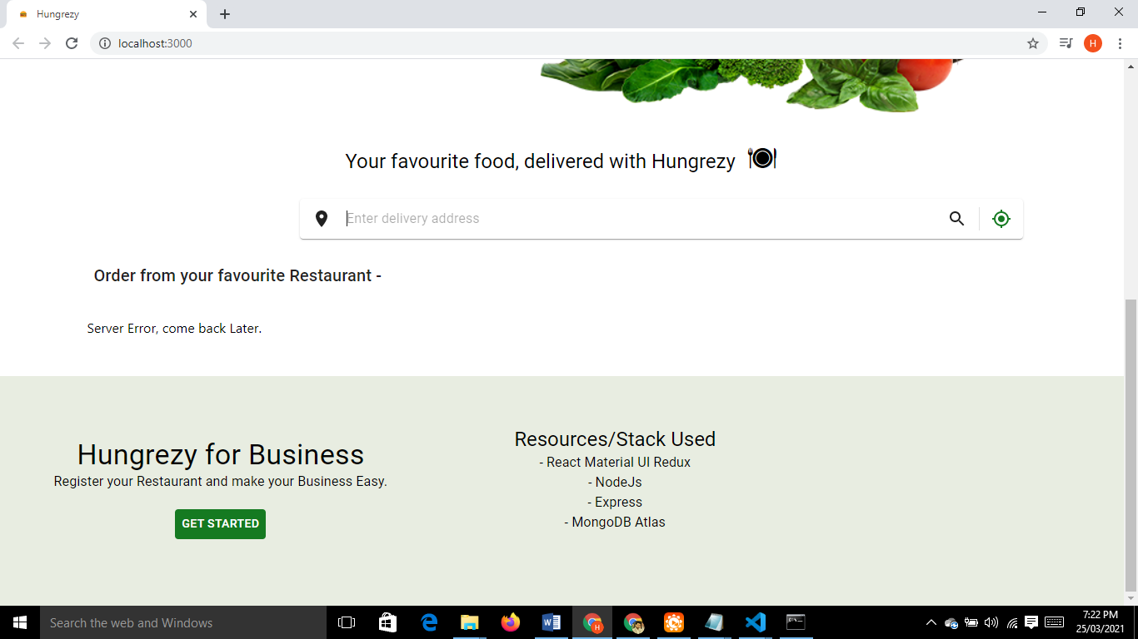
Restaurant Registration

Slide 6
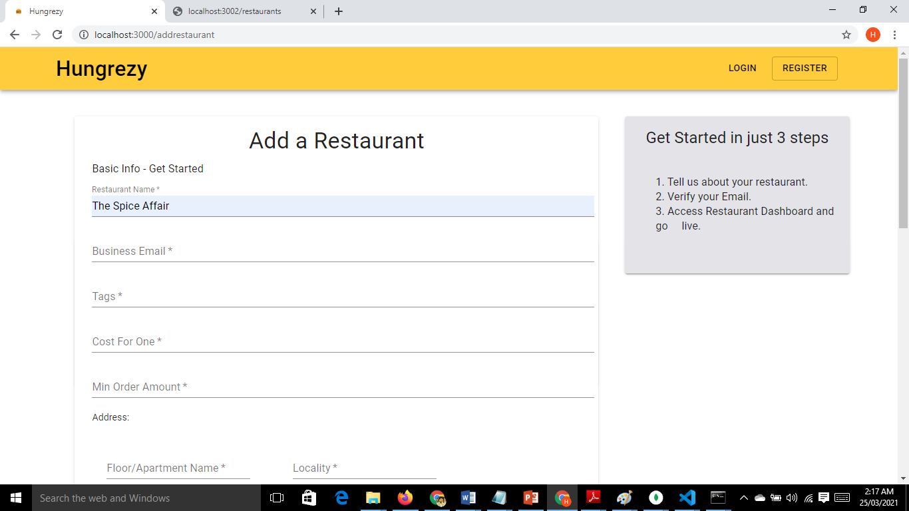
Steps to Register Restaurant

Slide 7
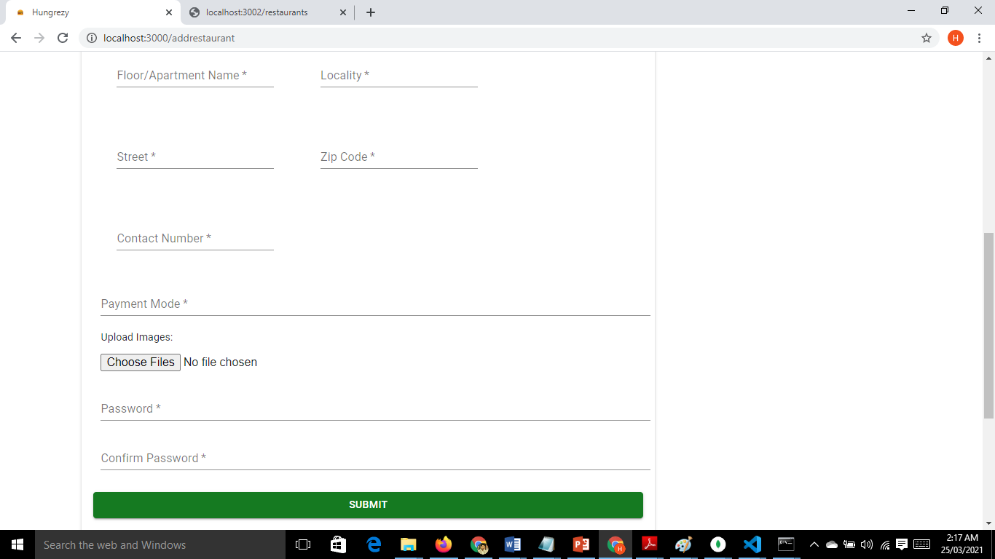

Slide 8
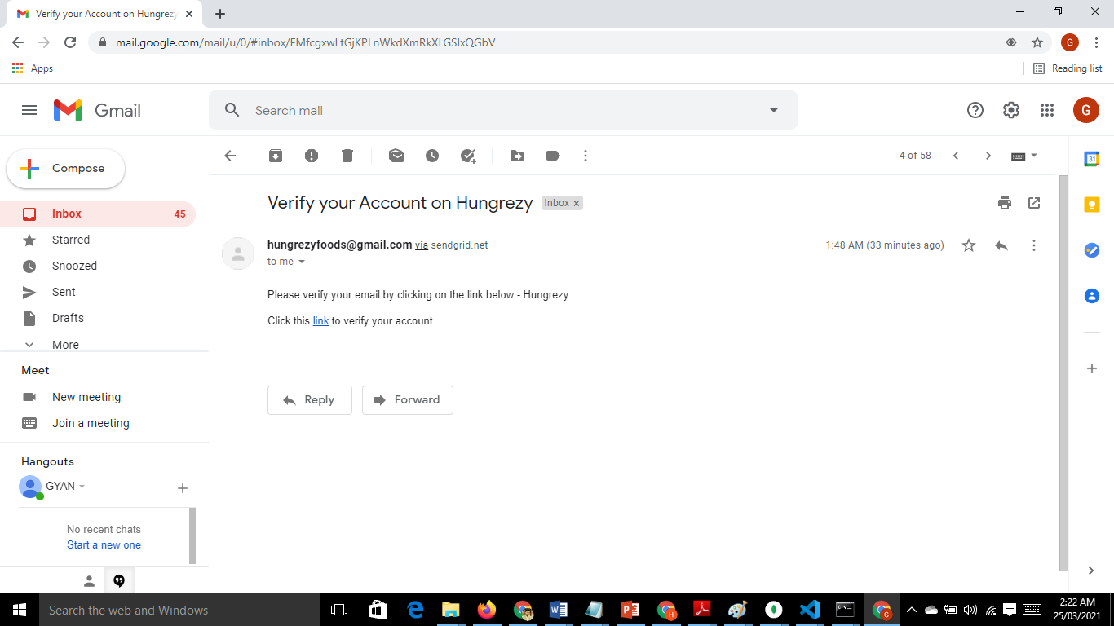
Email verification of Restaurant

Slide 9
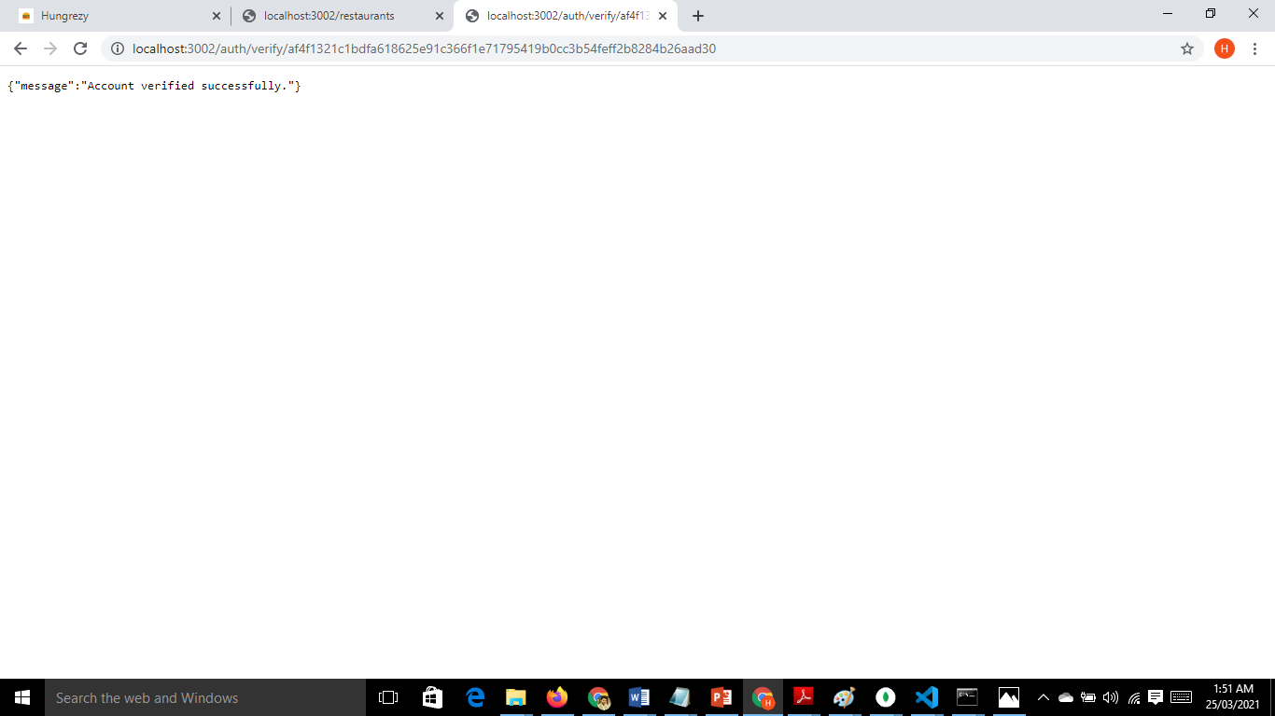

Slide 10
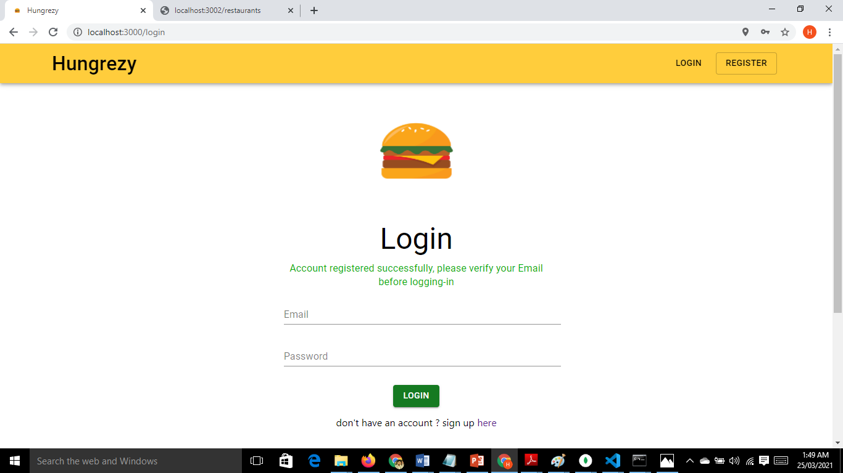
Restaurant Login

Slide 11
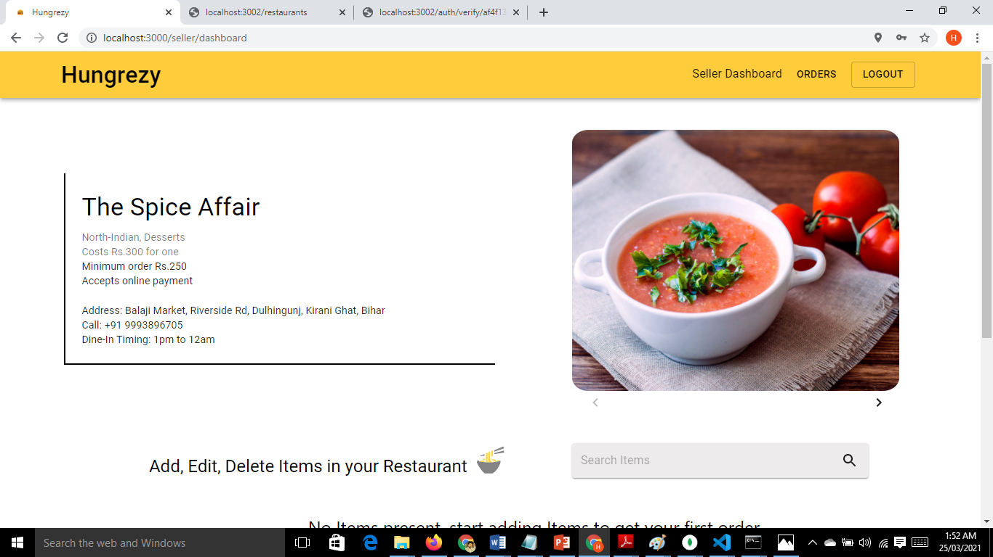
Seller Dashboard

Slide 12
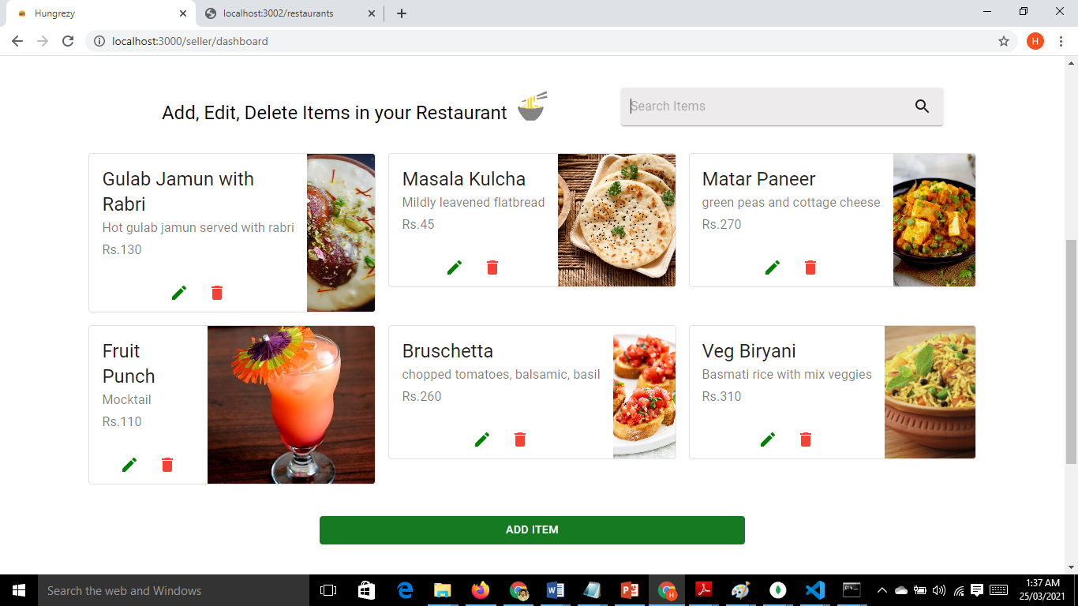
CRUD Item

Slide 13
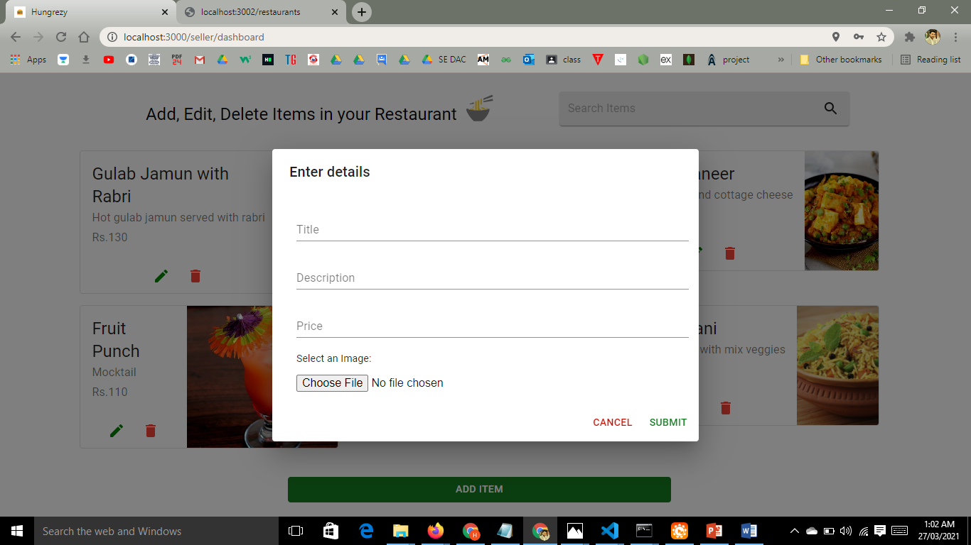
Add Item

Slide 14
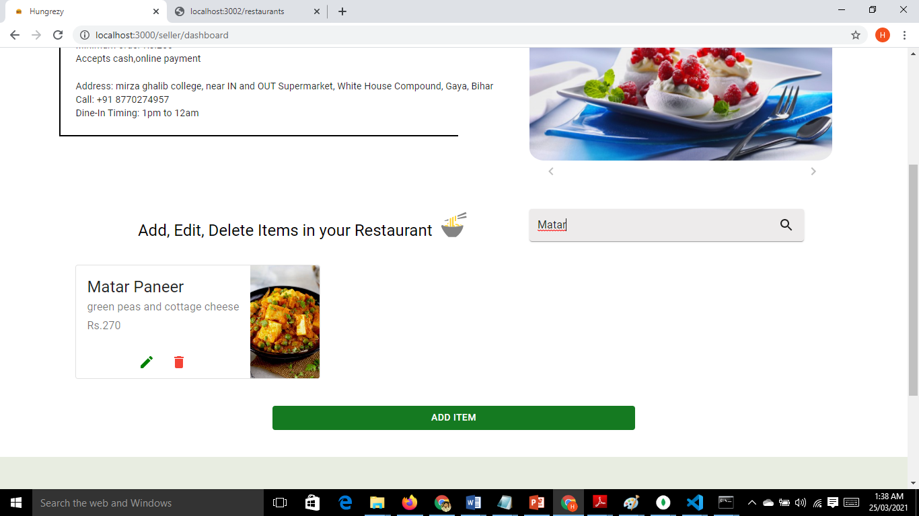
Search Item for CRUD

Slide 15
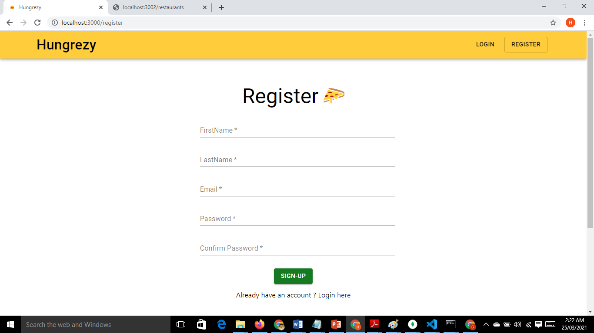
Register User

Slide 16
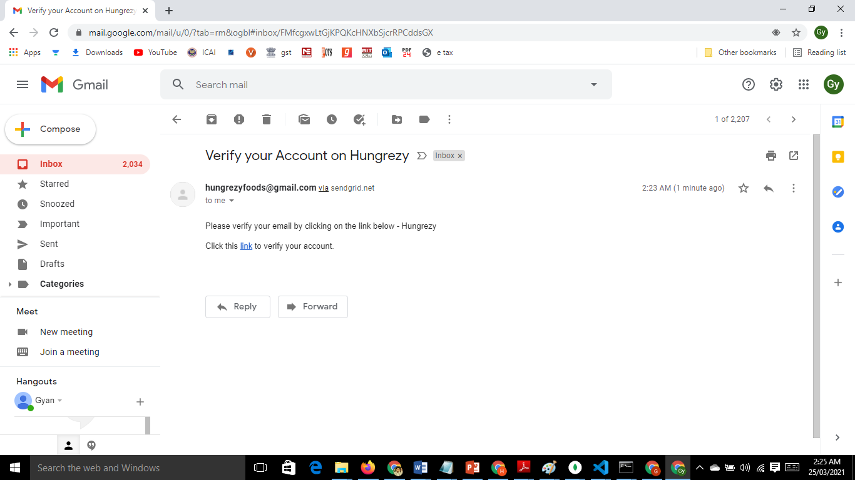
User’s Email Verification

Slide 17
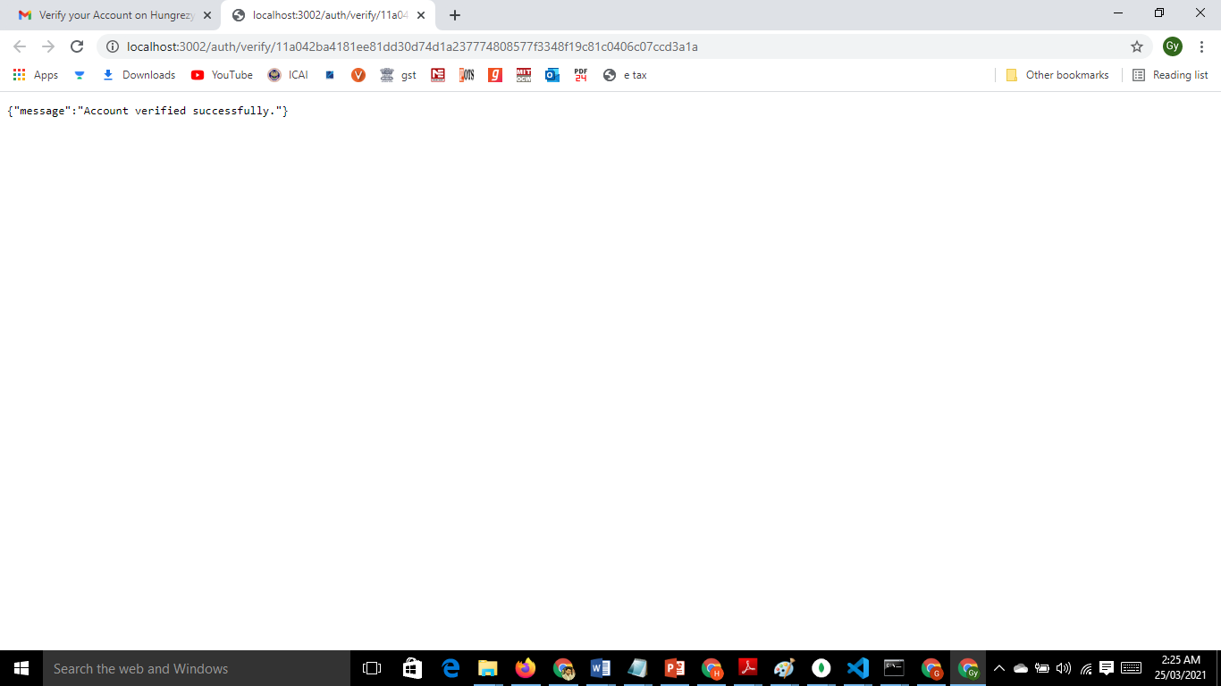
User Verification Successful

Slide 18
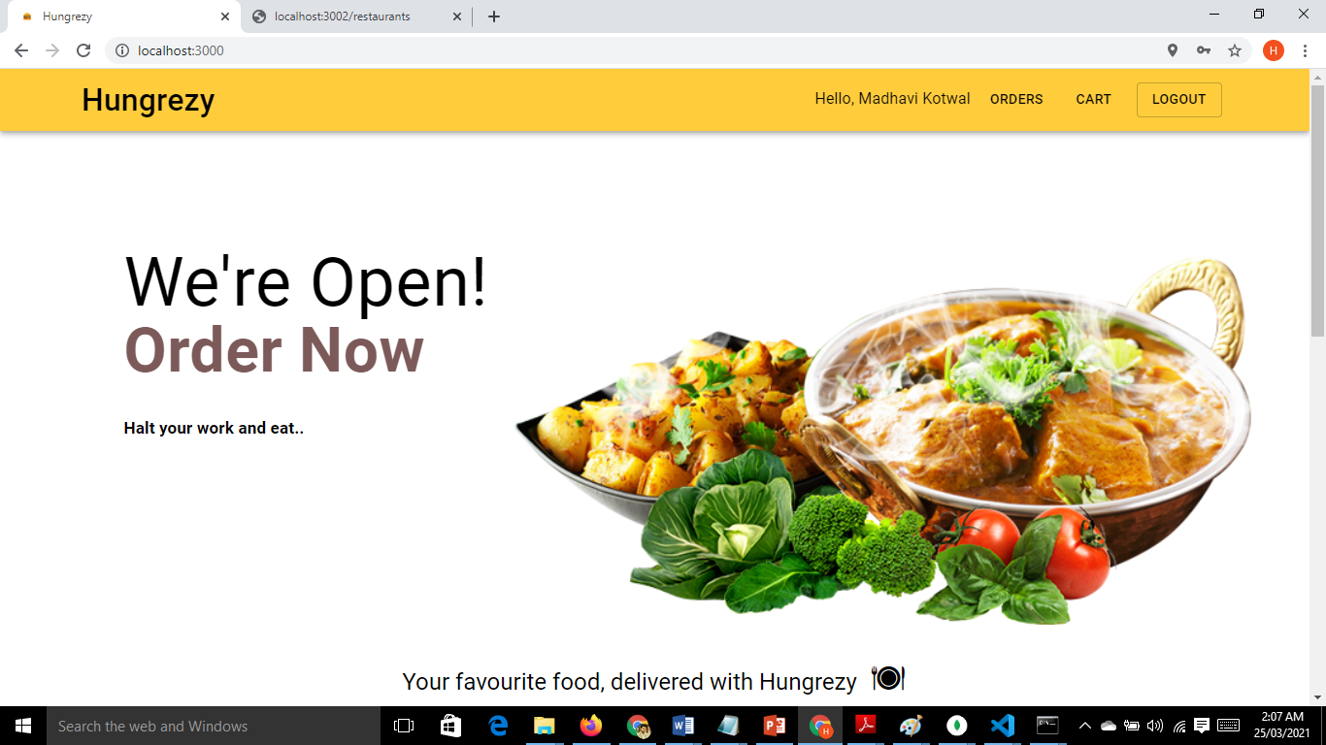
User Dashboard

Slide 19
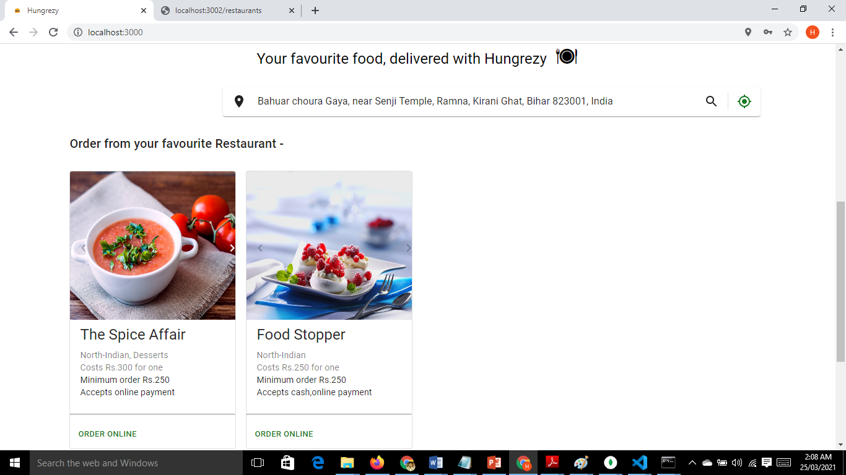
Search Nearby Restaurants

Slide 20
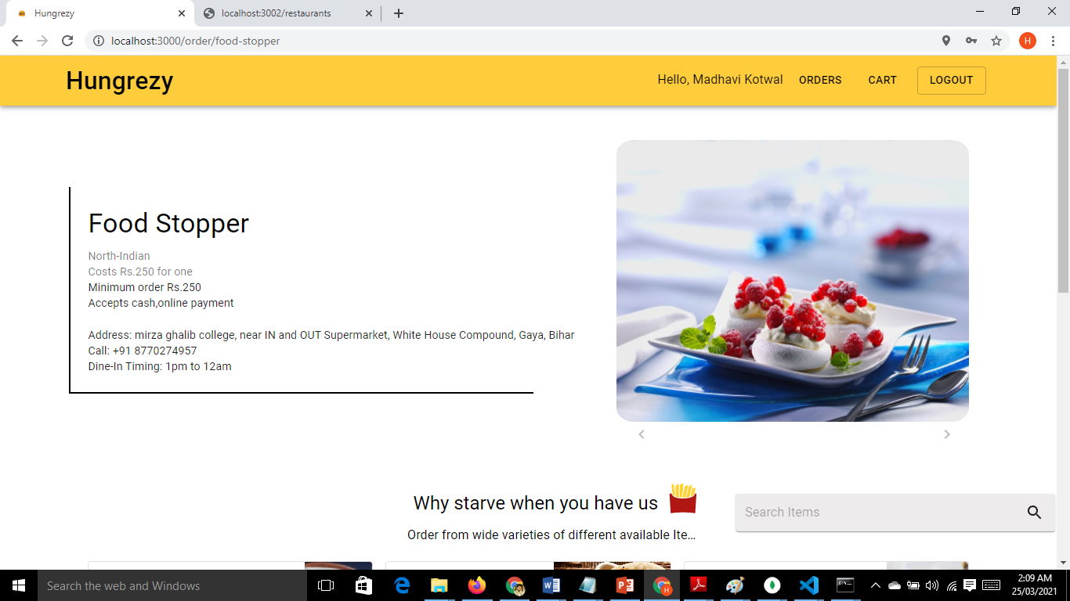
Selected Restaurant

Slide 21
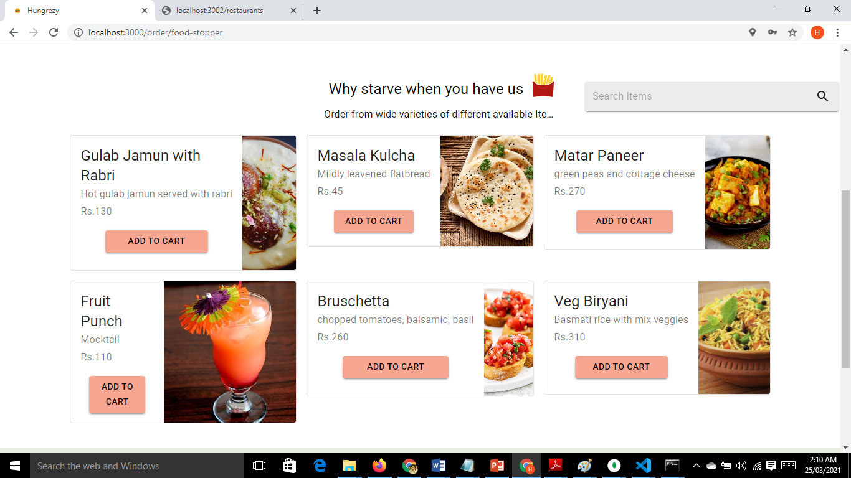
Available Items

Slide 22
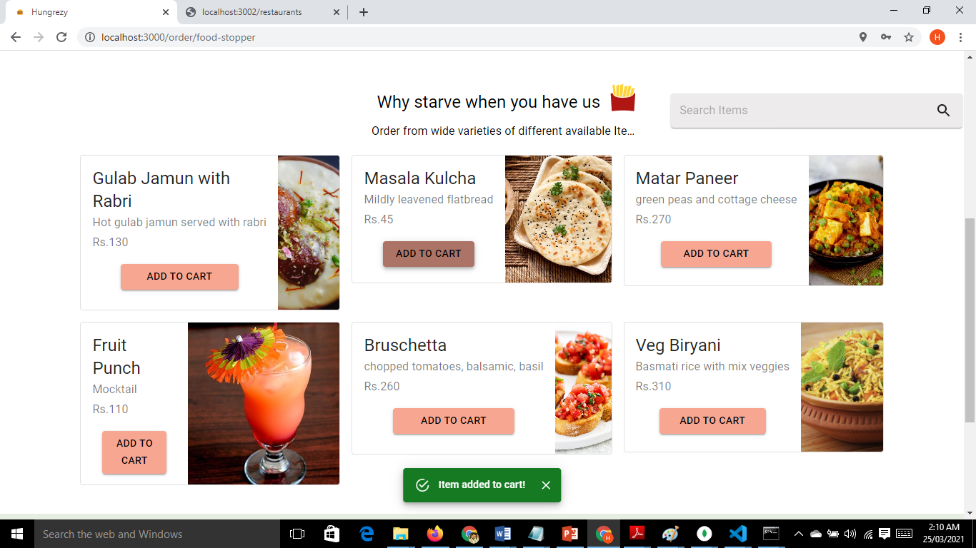
Add to Cart

Slide 23
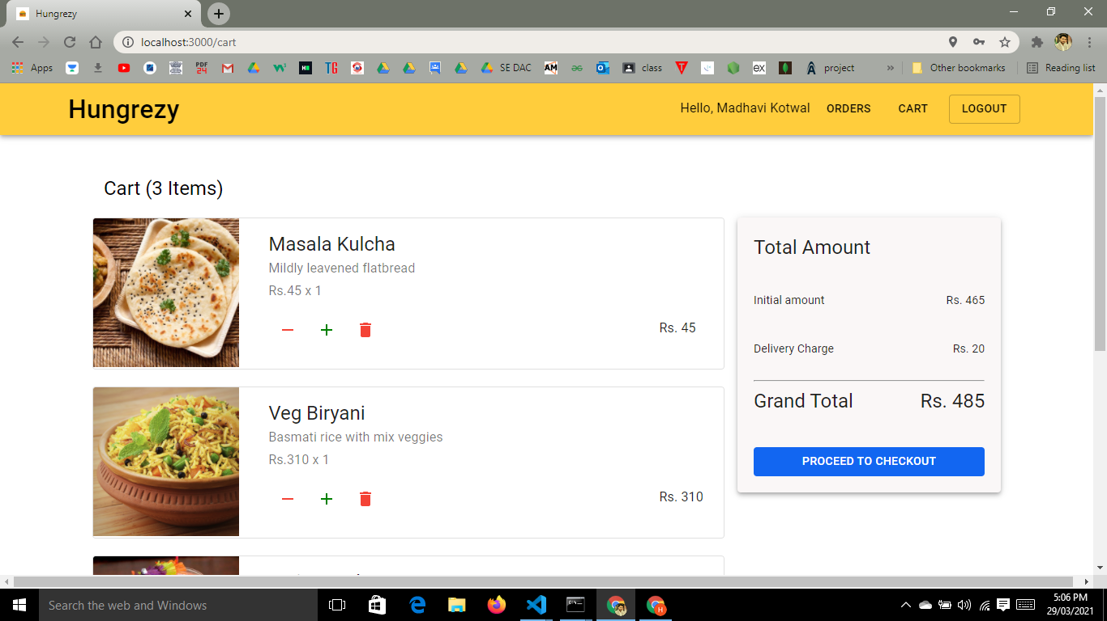
Order List

Slide 24
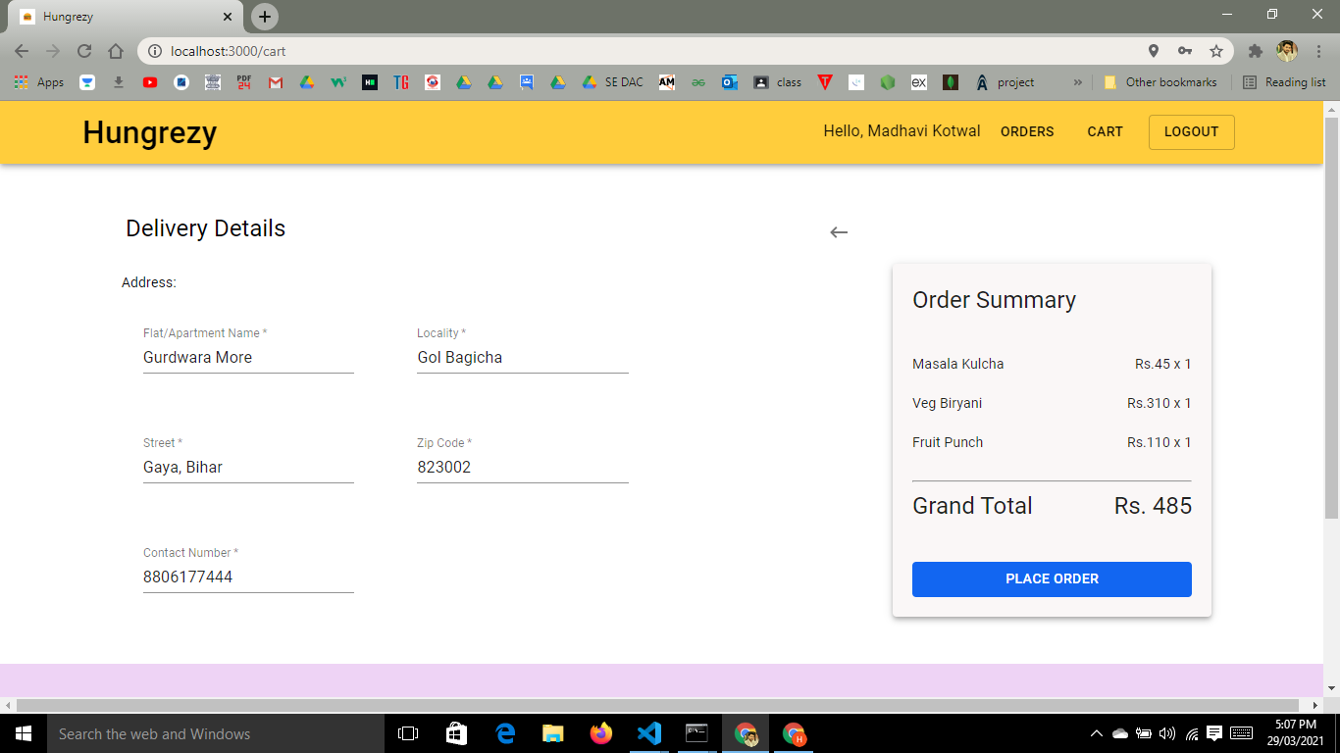
Delivery Details

Slide 25
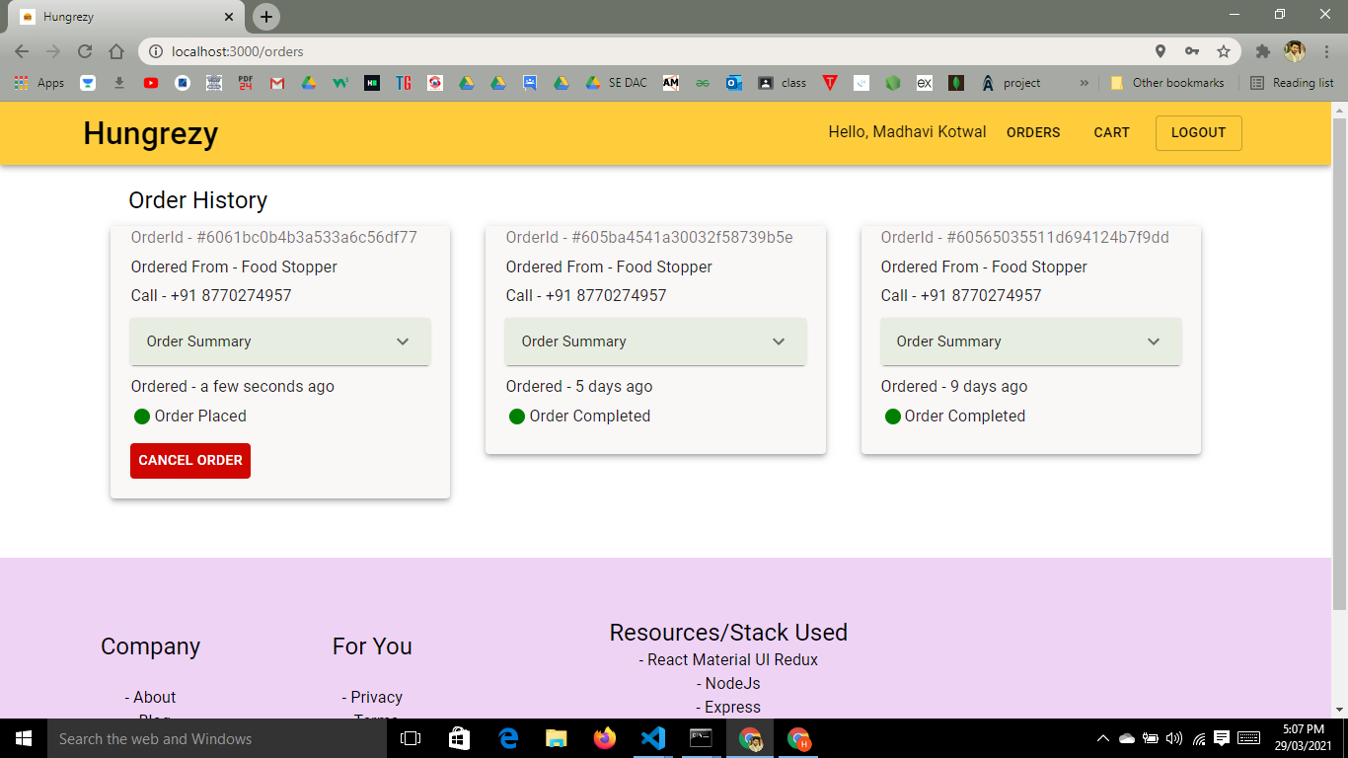
User Placed Orders

Slide 26
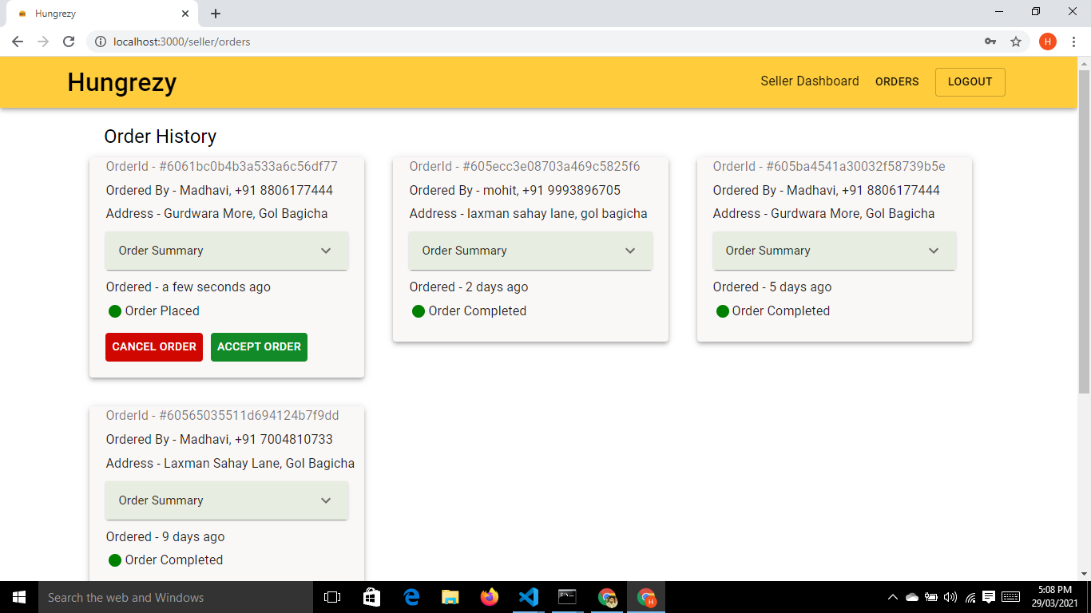
Seller Accept or Cancel Orders

Slide 27
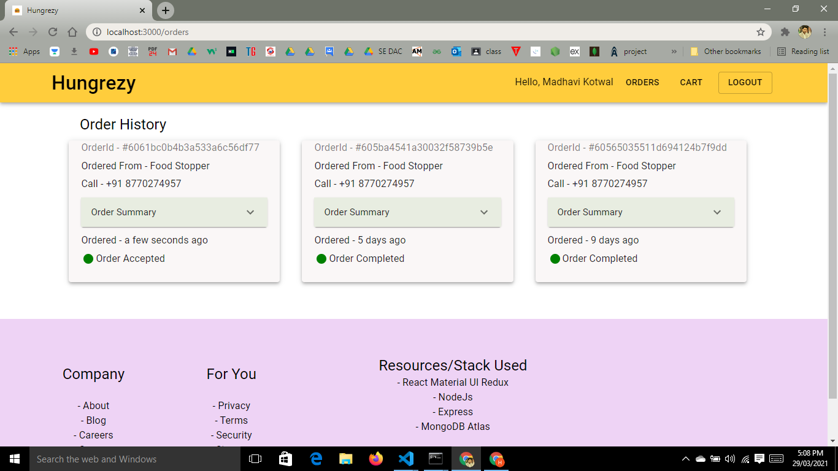
User Order Accepted

Slide 28
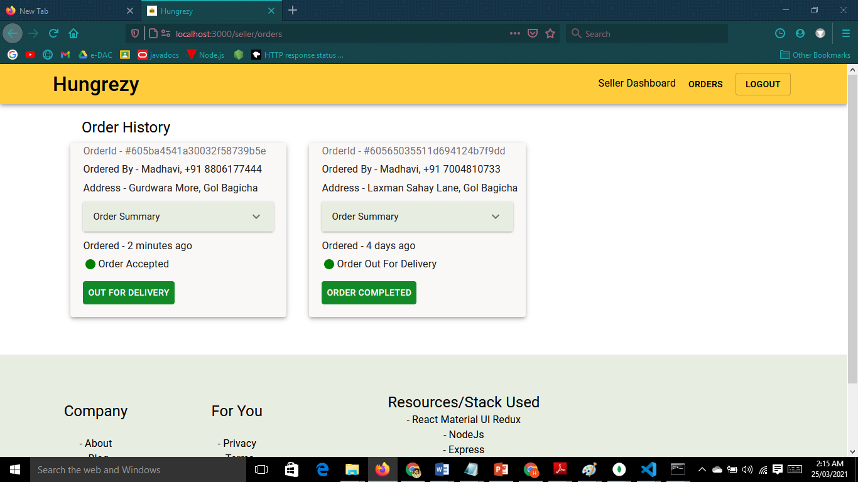
Seller Updating Order Status

Slide 29
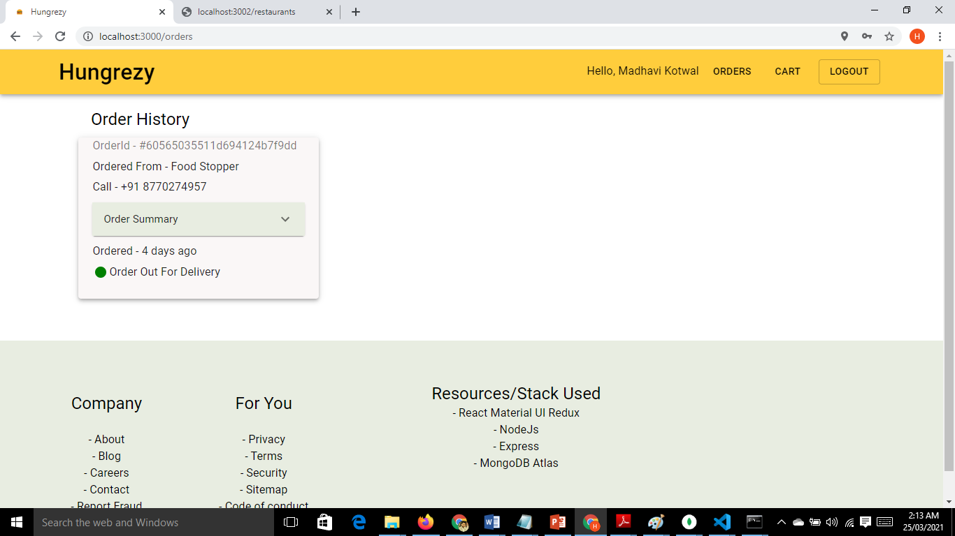
User’s Order Update

Slide 30
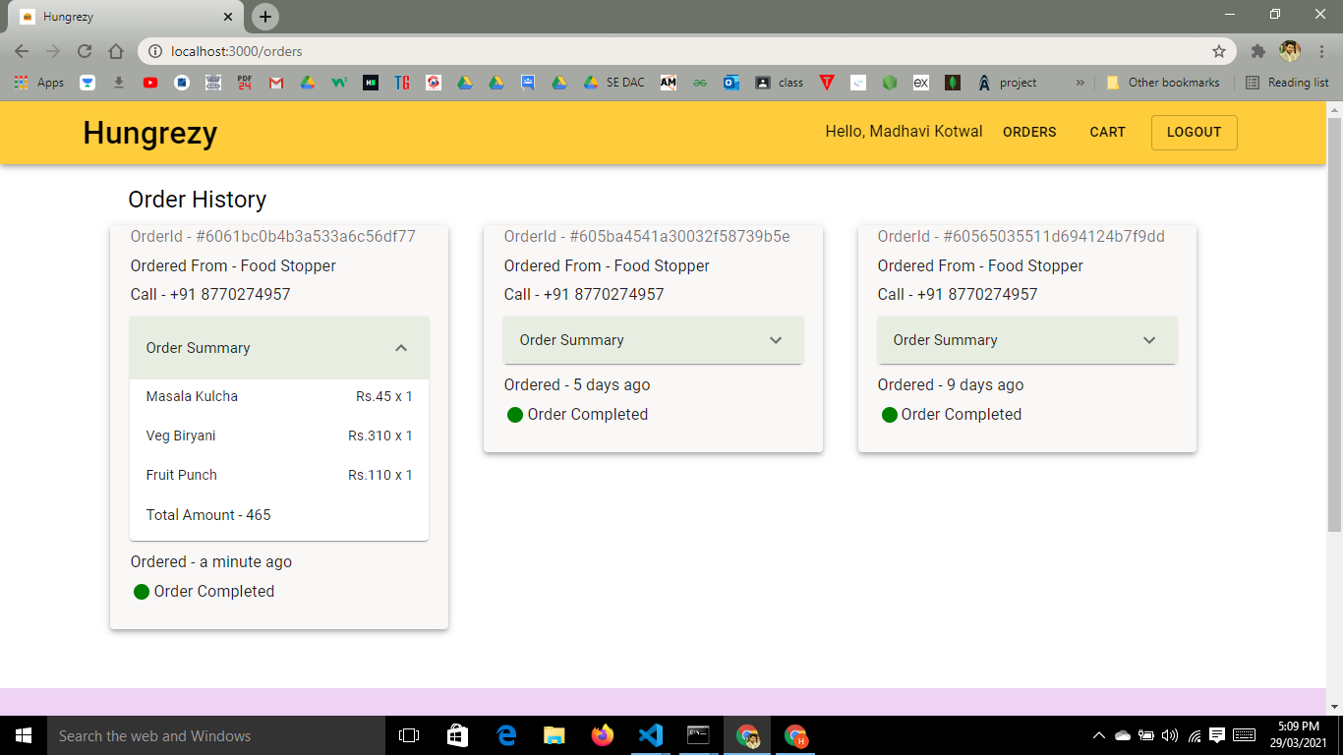
Order Completed

Slide 31
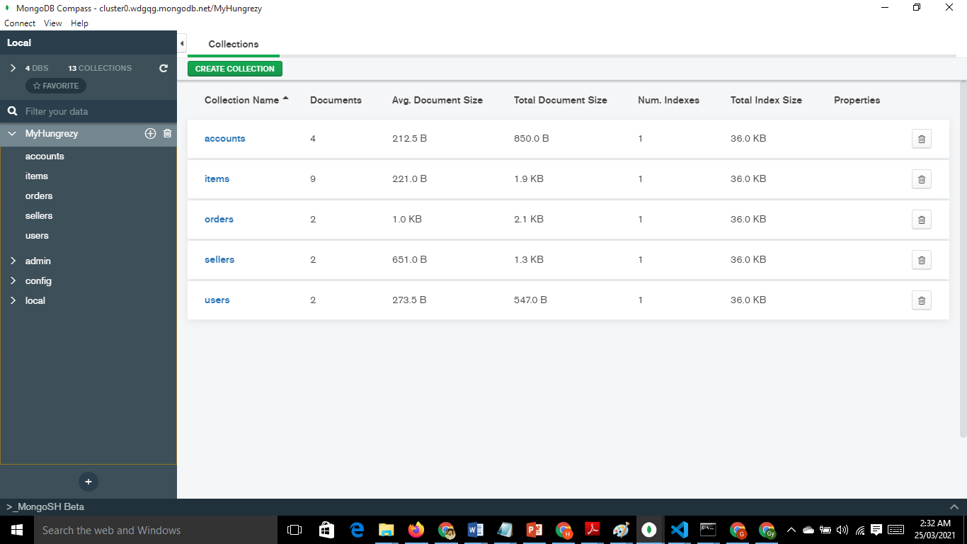
Models Created in MongoDB

Slide 32


